Slide 1

Data Analysis Portfolio Project
Exploratory Data Analysis on real-life banking data
By : Rutvi Gajipara

Slide 2
OUTLINE :
Executive summary
Introduction
Methodology
Results
Conclusion

Slide 3
EXECUTIVE SUMMARY
Targeting the appropriate customers for loans holds significance for banks across various dimensions such as
1. Risk Management
2. Profitability
3. Customer Satisfaction
4. Regulatory Compliance
By directing their attention towards customers with a higher likelihood of loan repayment, banks can mitigate the risk of defaults, thereby safeguarding their financial stability.
The data was sourced from Kaggle's public datasets, meticulously gathered, cleansed, subjected to exploratory analysis, and finally visualized through Python graphs and plots.

Slide 4
INTRODUCTION
This presentation utilized data analytics to identify potential loan recipients by analyzing various factors including income, occupation, education, family status, and type of employer. The following inquiries were investigated using the data :
1. Determining suitable candidates for loan offers.
2. Identifying customers who should not be approached for loans.
3. Calculating appropriate loan amounts and annuities based on applicants' data.

Slide 5
METHODOLOGY
Data with several Datatypes was gathered from Kaggle public data sets.
To ensure its integrity, a series of functions were such as handling null values, eliminating redundant columns, normalizing data, arranging values, enhancing column clarity through renaming, and identifying and addressing outliers using techniques like Box plot analysis.
Additionally, Python functions including mean, mode, median, group by, correlation analysis, unstacking, summation, sorting, and data merging were utilized to extract significant insights from the data.
For visualization purposes, a range of plotting techniques such as line plots, bar plots, KDE plots, count plots, and scatter plots were employed.

Slide 6

RESULTS :

Slide 7
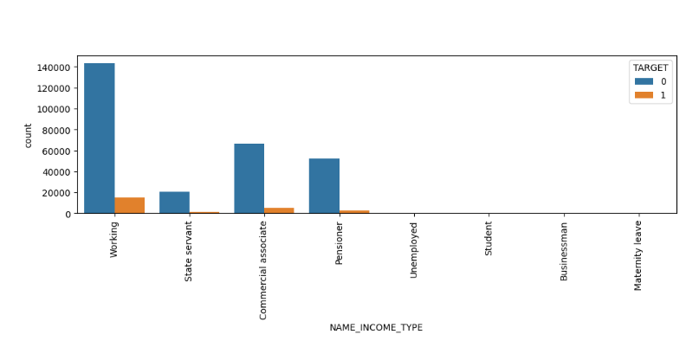
Numeric variable analysis :
Most of the Customer given loan had income between 0 – 1 Million
Most of the loan were given for the credit amount of 0 – 1 Million
Most of the Customer are paying loan amount of 0 – 50K
Most of the loan given for the goods price ranges between 0 – 1 Million

Slide 8
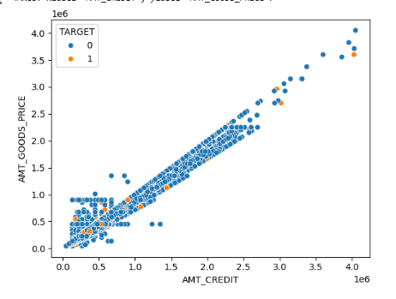
Bivariate Analysis :
Amount credit and Goods prices are linearly corelated, hence if goods price go up, amount credit will also increase
If credit amount is increasing, Defaulter count is also going up
People earning less than 1 Million are more likely to take loans
Customer with 5 or more than 5 children are turning into a defaulters
Customer who can pay loan amount of more than 100 K are more likely to get a loan

Slide 9
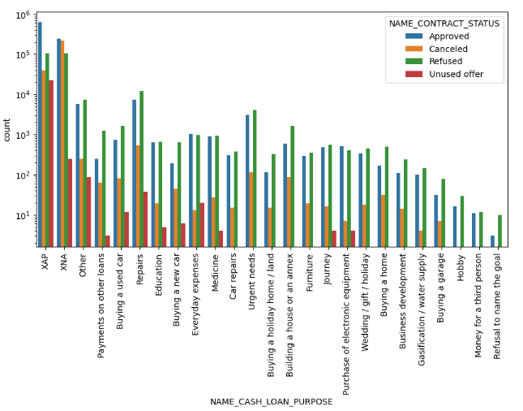
Merged Data Analysis :
Most loan previously applied by Customer was for repairing purpose, and same category have highest cancellation rates
80 – 90% of previous loan applications are aligned with the current data
90% Customers turns out a repayor for all contract status
Previously unused offers by customers are current highest number of defaulters despite of higher income

Slide 10
Conclusion
Customer to Target :
Highly educated customers
Working in business entity 3 or self employed
Customer with own house/apartment
Customer with 3 or less than 3 kids
Customer working as accountants, core staff and laborers
Customer having income between 0 to 1 Million
Customer to avoid :
Customer in Transport industry
Customer working as Low-skill laborers and Drivers
Customers with High income
Customers who have previous unused offers

Slide 11

End of Presentation
Thank you

